Slide 1

Shape matching using a dynamic time warping algorithm
Group: Project task 1- group 4 Group Members:
- Singari Sahith Kumar (1446809)
- Bandaru Vinay Kumar (1447125 )

Slide 2


Image Template Matching and Analysis using Dynamic Time Warping (DTW)
The primary objective of this project is to develop an intelligent system capable of recognizing and matching image patterns within complex visual data. We aim to create a robust framework that can find applications in various domains, including object recognition, medical image analysis, and more
Source: NEC Corporation Copyright: Elnur/123RF

Slide 3
Facial considerations
Individual Facial Components (Eyes, Nose, Mouth):
Advantages:
Fine-grained matching: You can assess the similarity of each facial component separately, allowing for more detailed analysis.
Flexibility: You can define different matching thresholds or criteria for different facial components.
Considerations:
Complexity: Managing multiple DTW computations for each facial component can be more complex in terms of code and processing.
Entire Face as a Single Entity:
Advantages:
Simplified analysis: Treating the entire face as one entity simplifies the matching process.
Overall face matching: You can assess whether the entire face closely resembles the template, which might be suitable for face recognition tasks.
Considerations:
Loss of granularity: You may lose fine-grained information about individual facial components.
Uniformity: The entire face needs to meet the matching criteria, which might be less flexible.

Slide 4


Input Images and Paths Arrangement

Slide 5


Slide 6
face_cascade = cv2.CascadeClassifier('haarcascade_frontalface_default.xml’) Link
Input Images to check: Rename to "Check” and place the image in this folder" given_image_path = copy and paste the above placed image in this line

Slide 8

Project Initialization:
import cv2
import os
import pandas as pd
from fastdtw import fastdtw
import numpy as np
import matplotlib.pyplot as plt
# Load the pre-trained face detection model
face_cascade = cv2.CascadeClassifier('haarcascade_frontalface_default.xml')
GITHUB Link

Slide 9
Data Preprocessing:
# Load and preprocess the template sequences for shape matching
template_sequences = {} # Store template sequences here
# Iterate over the images in the 'images' folder
for filename in os.listdir('images'):
if filename.endswith('.jpg') or filename.endswith('.jpeg') or filename.endswith('.png'):
# Load the image
image_path = os.path.join('images', filename)
template_image = cv2.imread(image_path)
template_gray = cv2.cvtColor(template_image, cv2.COLOR_BGR2GRAY)
# Extract the contour of the template image
contour, _ = cv2.findContours(template_gray, cv2.RETR_EXTERNAL, cv2.CHAIN_APPROX_SIMPLE)
template_sequence = np.squeeze(contour) # Flatten to a 2D array
template_sequences[filename] = template_sequence
GITHUB Link

Slide 10
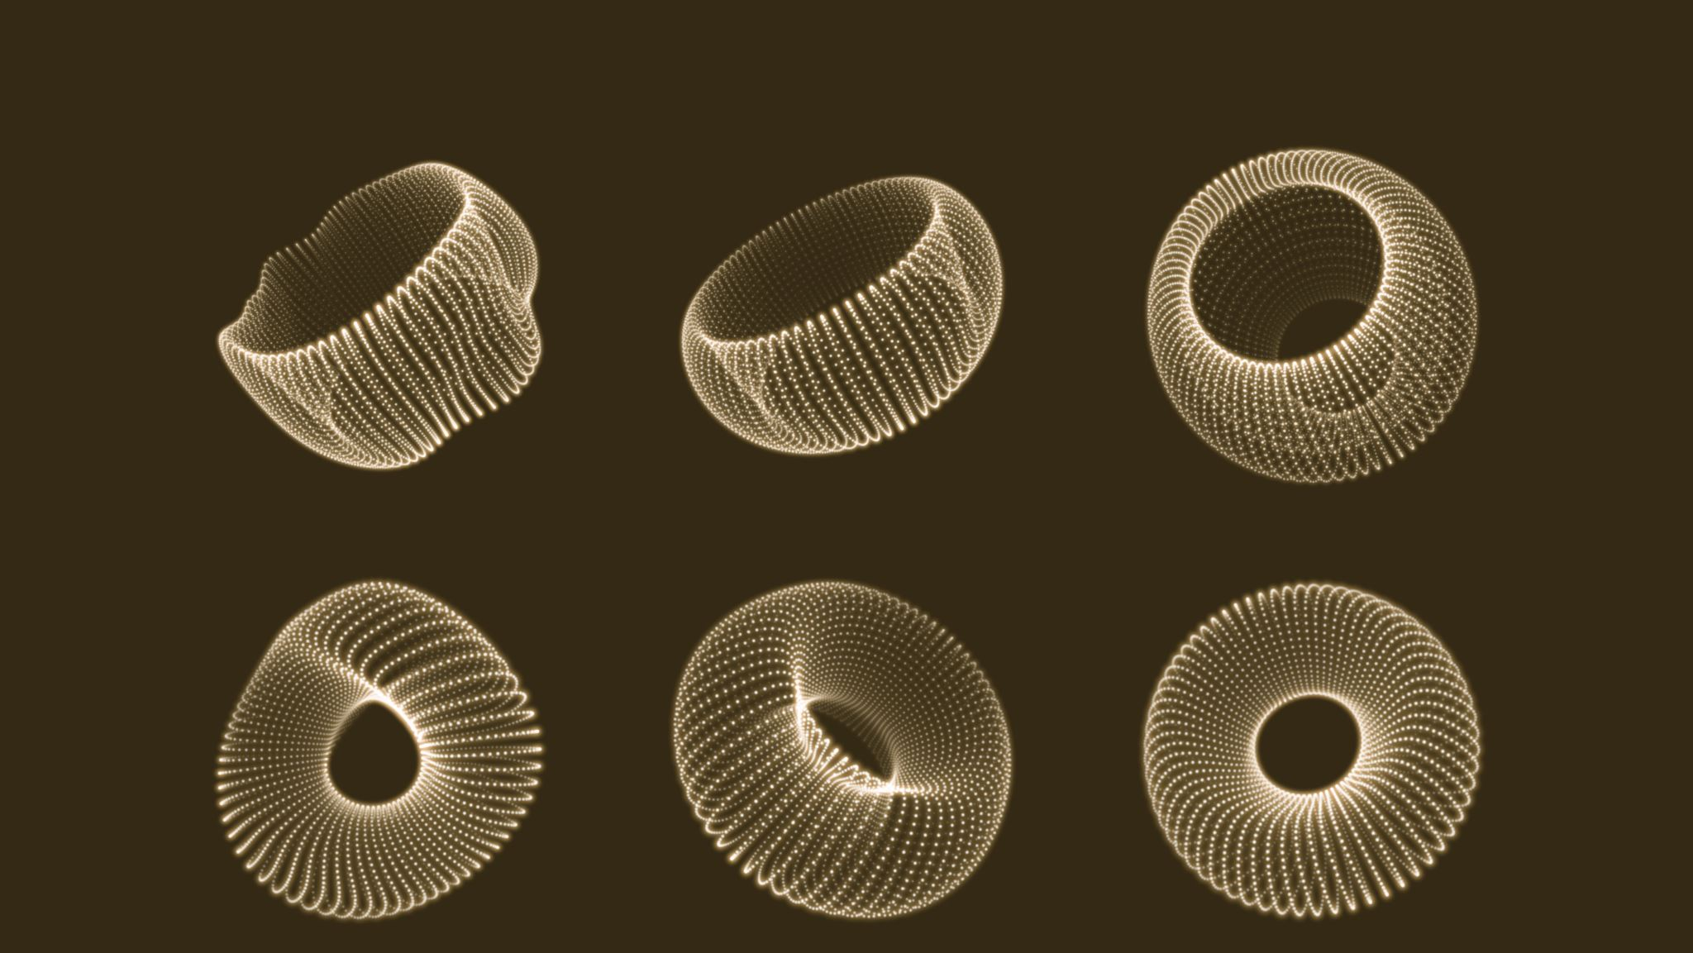
Dynamic Time Warping (DTW):
# Function to perform DTW shape matching
def shape_matching(template_sequence, target_sequence, threshold):
# Compute the DTW distance between the sequences
distance, _ = fastdtw(template_sequence, target_sequence)
if distance < threshold:
return True, distance
else:
return False, distance
GITHUB Link

Slide 11
Visualization and Analysis:
# Inside the loop where you perform shape matching and create the visualization
for template_filename, template_sequence in template_sequences.items():
match, distance, path = shape_matching_with_visualization(template_sequence, given_sequence, threshold=200)
if match:
# Find peak positions
max_template_position = np.argmax(template_sequence, axis=0)
max_given_position = np.argmax(given_sequence, axis=0)
# Extract the x and y coordinates of the matched points
matched_x = [template_sequence[i, 0] for i, _ in path]
matched_y = [template_sequence[i, 1] for i, _ in path]
# Plot the sequences and highlight the matched points
plt.figure(figsize=(8, 4))
plt.plot(template_sequence[:, 0], template_sequence[:, 1], label='Template Sequence', marker='o', markersize=5)
plt.plot(given_sequence[:, 0], given_sequence[:, 1], label='Given Sequence', marker='x', markersize=5)
plt.scatter(matched_x, matched_y, c='r', label='Matched Points') # Plot matched points in red
plt.legend()
plt.title(f"Matching Result with {template_filename} (DTW Distance: {distance})")
plt.xlabel("X")
plt.ylabel("Y")
plt.show()
GITHUB Link

Slide 12
Result Storage:
# Save the matching results to an Excel file
output_file = 'matching_results ' + photo_name + '.xlsx'
matching_data = pd.DataFrame({'Template': [result[0] for result in matching_results], 'DTW Distance': [result[2] for result in matching_results]})
save_data_to_excel([matching_data], output_file)
GITHUB Link

